Slide 1
Vehicle Dynamics and Simulation
Using Eigenvalues and Eigenvectors
Dr B Mason

Slide 2
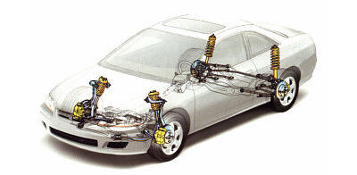
Lecture overview
Transfer functions
Modal motion in free vibration
Eigenvalues
Eigenvectors

Slide 3
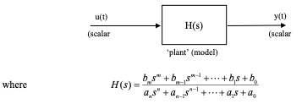
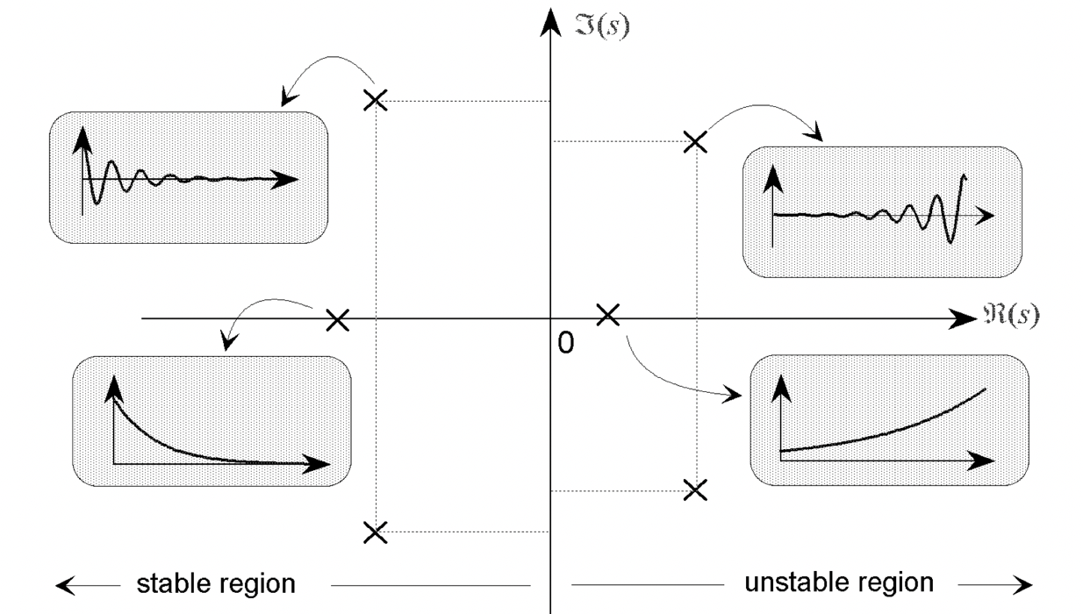
Transfer Functions
Transfer functions relate input to output
The roots/poles of the characteristic equation determine frequency and damping of each mode i.e. the dynamics of the system
In state space form additional information is also available describing mode shapes from the A matrix
Notes:
Linear
Assume zero initial conditions

Slide 4


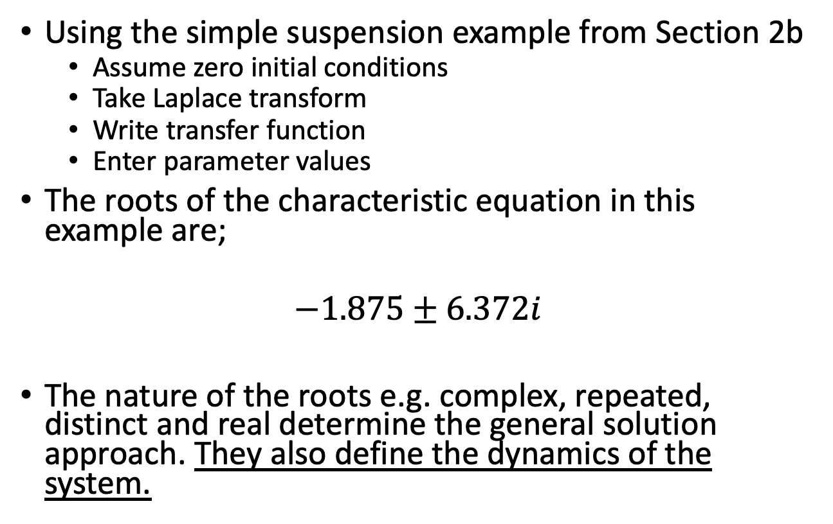
Simple Example
Using the simple suspension example from Section 2b
Assume zero initial conditions
Take Laplace transform
Write transfer function
Enter parameter values
The roots of the characteristic equation in this example are;
$$−1.875±6.372i$$
The nature of the roots e.g. complex, repeated, distinct and real determine the general solution approach. They also define the dynamics of the system.

Slide 5

Laplace Transform and the Transfer Function
State space representation;
$\overset{.}{x}=Ax+Bu$ [1]
$y=Cx+Du$ [2]
Assuming zero initial conditions and taking the Laplace transform of [1];
$$sX=AX+BU$$
$$(sI−A)X=BU$$
$$X={\left(sI−A\right)}^{−1}BU$$
Substituting into [2];
$$Y=C{\left(sI−A\right)}^{−1}BU+DU$$
$H(s)=C{\left(sI−A\right)}^{−1}B+D$ [3]
Notes:
General solution

Slide 6
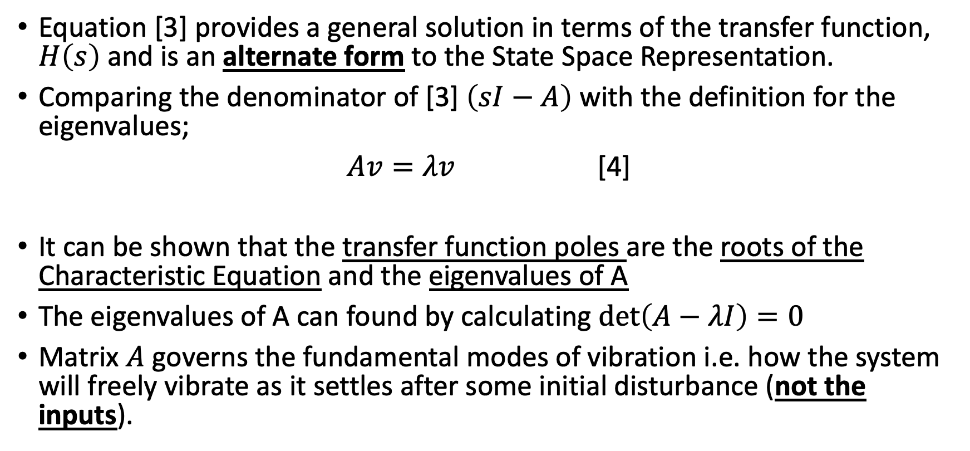
Laplace Transform and the Transfer Function
Equation [3] provides a general solution in terms of the transfer function, $H\left(s\right)$ and is an alternate form to the State Space Representation.
Comparing the denominator of [3] $\left(sI−A\right)$ with the definition for the eigenvalues;
$Av=λv$ [4]
It can be shown that the transfer function poles are the roots of the Characteristic Equation and the eigenvalues of A
The eigenvalues of A can found by calculating $\det\left(A−λI\right)=0$
Matrix $A$ governs the fundamental modes of vibration i.e. how the system will freely vibrate as it settles after some initial disturbance (not the inputs).
The eigenvalues therefore tell us about the damping and natural frequency of each mode of the system
Eigenvectors of A
Eigenvalues of A
Notes:
The denominator of the transfer function – system poles are equivalent to the eigenvalues

Slide 7
worked example (reminder)

Slide 8
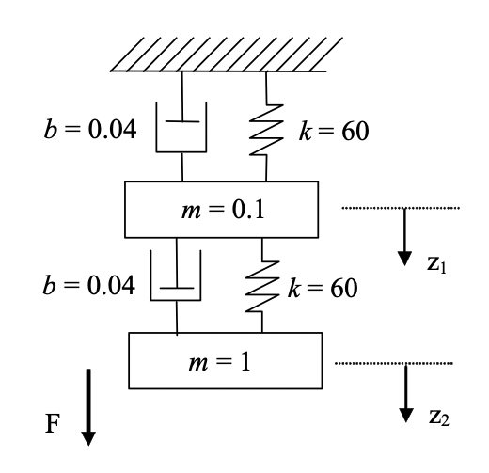
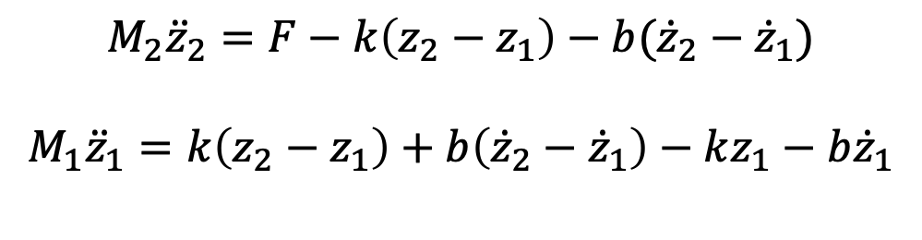
An Example
The equations of the system are (expressed in terms of two second order differential equations);
$M_{2}{\ddot{z}}_{2}=F−k\left(z_{2}−z_{1}\right)−b({\dot{z}}_{2}−$ ${\dot{z}}_{1})$
$$M_{1}{\ddot{z}}_{1}=k\left(z_{2}−z_{1}\right)+b\left({\dot{z}}_{2}−{\dot{z}}_{1}\right)−kz_{1}−b{\dot{z}}_{1}$$

Slide 9
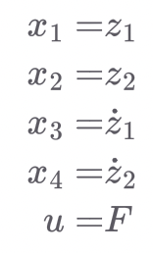
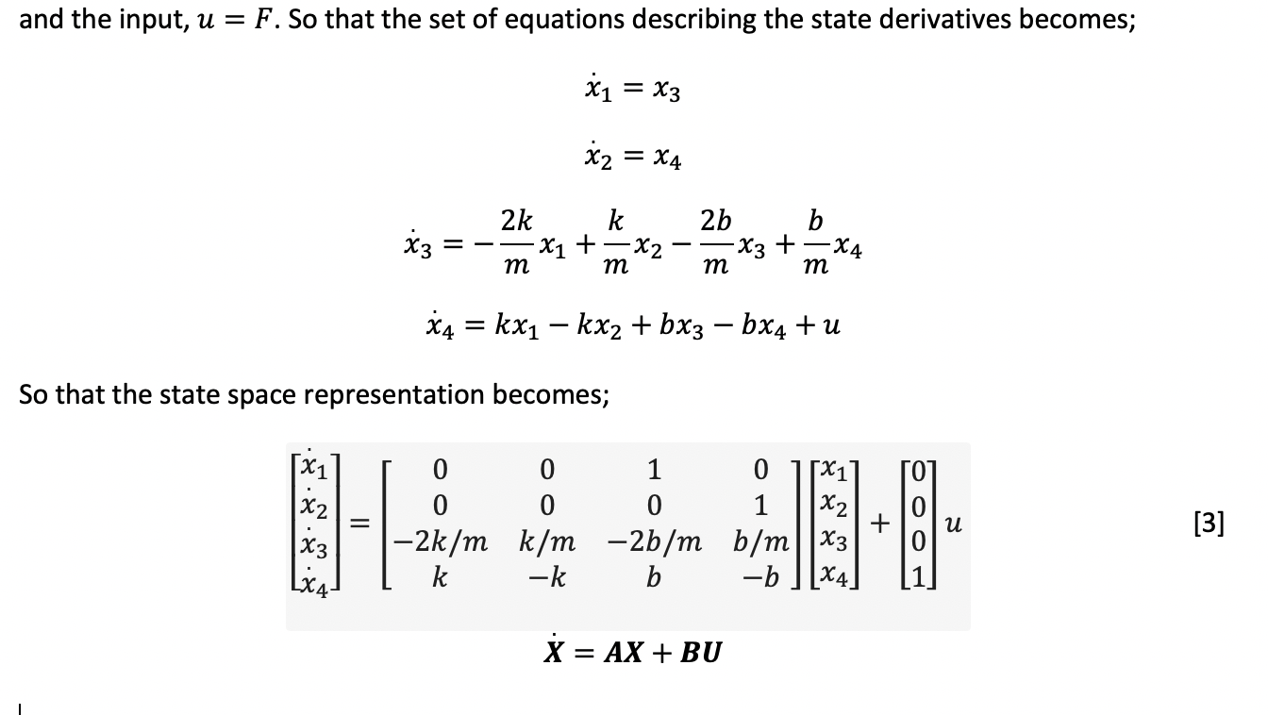
Choosing one deflection and one velocity state per mass;

Slide 10
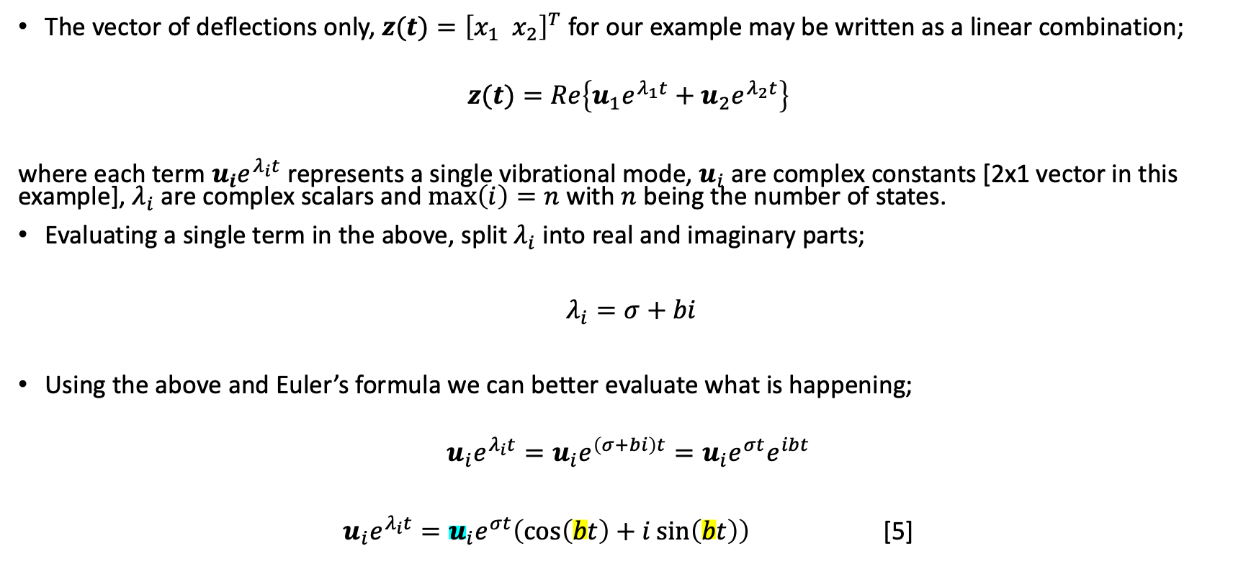
Modal motion in free vibration – Eigenvalues
The vector of deflections only, $z(t)={\left[x_{1} { x}_{2}\right]}^{T}$ for our example may be written as a linear combination;
$$z(t)=Re\left\{u_{1}e^{λ_{1}t}+u_{2}e^{λ_{2}t}\right\}$$
where each term $u_{i}e^{λ_{i}t}$ represents a single vibrational mode, $u_{i}$ are complex constants [2x1 vector in this example], $λ_{i}$ are complex scalars and $\max\left(i\right)=n$ with $n$ being the number of states.
Evaluating a single term in the above, split $λ_{i}$ into real and imaginary parts;
$λ_{i}=σ+bi$
Using the above and Euler’s formula we can better evaluate what is happening;
$$u_{i}e^{λ_{i}t}=u_{i}e^{\left(σ+bi\right)t}=u_{i}e^{σt}e^{ibt}$$
$u_{i}e^{λ_{i}t}=u_{i}e^{σt}\left(\cos\left(bt\right)+i\sin\left(bt\right)\right)$ [5]
Notes:
a determines exponential response
b the frequency of the sinusoidal component

Slide 11
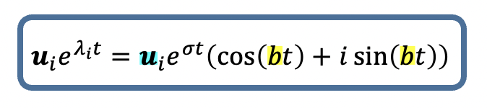

Modal motion in free vibration - Eigenvalues
From [5], $σ$ should be -ve bounding the response to a decaying exponential, $b$ gives the frequency of the sinusoidal component, $u_{i}$ (complex) determines the magnitude and the relative phase of each mode.
Modal decomposition of response
Solid line = total response
Short dash = sinusoidal component
Long dash = exponential decay

Slide 12
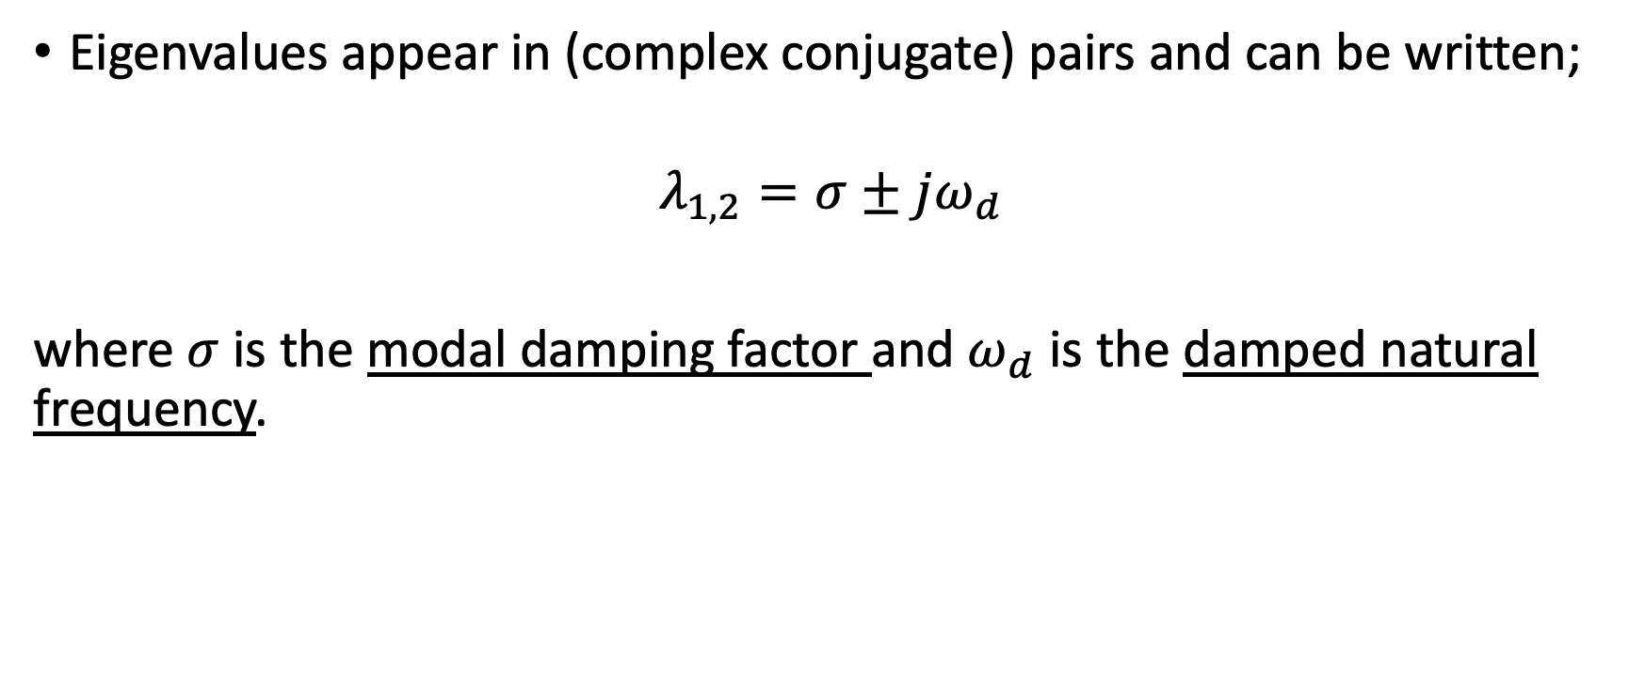
Modal motion in free vibration – Eigenvalues
Eigenvalues appear in (complex conjugate) pairs and can be written;
$$λ_{1,2}=σ±jω_{d}$$
where $σ$ is the modal damping factor and $ω_{d}$ is the damped natural frequency.

Slide 13
Check for yourself
Use the eig() function in MATLAB to determine the eigenvalues of matrix A from the previous example.
How are the complex conjugate pairs placed within the resulting vector?

Slide 14
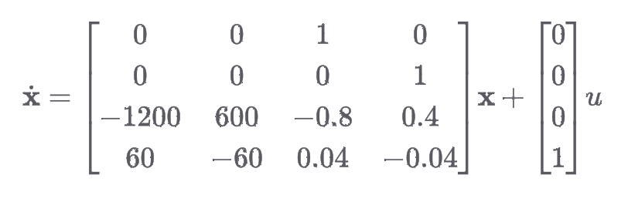
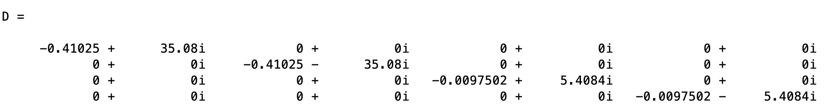
Check for yourself
$$λ_{1,2}=σ±jω_{d}$$

Slide 15
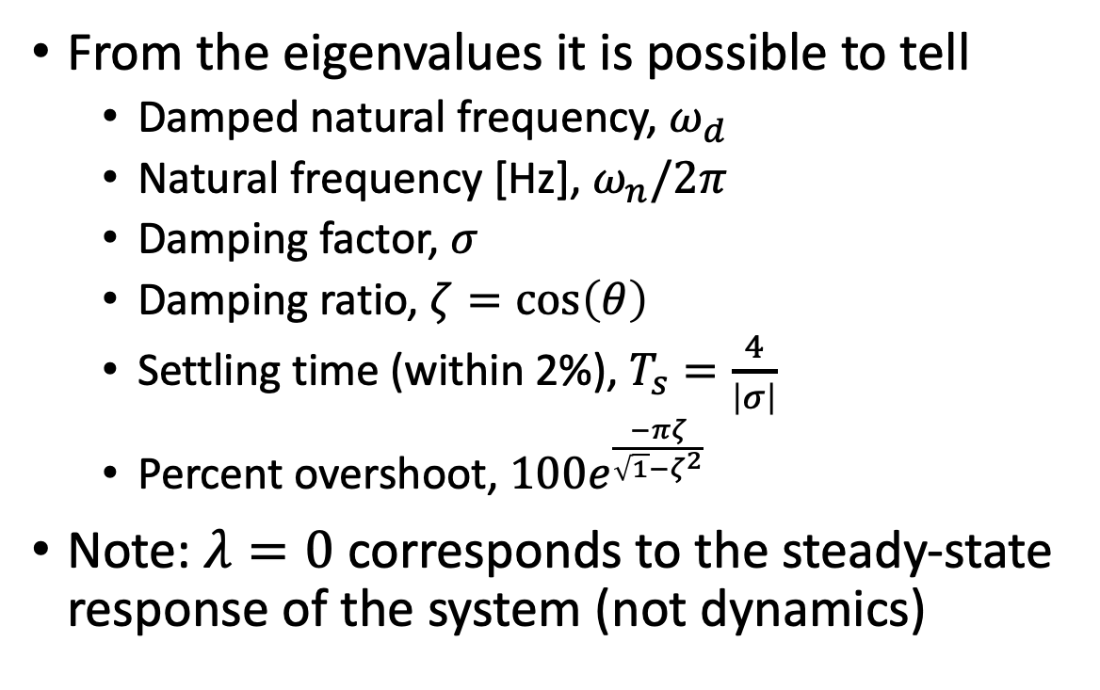
Modal motion in free vibration – Eigenvalues
From the eigenvalues it is possible to tell
Damped natural frequency, $ω_{d}$
Natural frequency [Hz], $ω_{n}/2π$
Damping factor, $σ$
Damping ratio, $ζ=\cos\left(θ\right)$
Settling time (within 2%), $T_{s}=\frac{4}{\left|σ\right|}$
Percent overshoot, $100e^{\frac{−πζ}{\sqrt{1}−ζ^{2}}}$
Note: $λ=0$ corresponds to the steady-state response of the system (not dynamics)

Slide 16
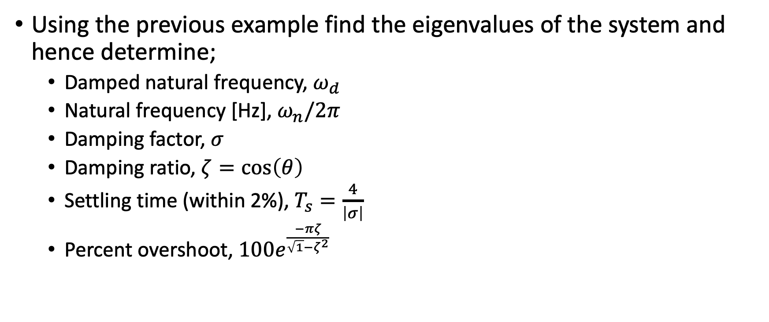
Check for yourself
Using the previous example find the eigenvalues of the system and hence determine;
Damped natural frequency, $ω_{d}$
Natural frequency [Hz], $ω_{n}/2π$
Damping factor, $σ$
Damping ratio, $ζ=\cos\left(θ\right)$
Settling time (within 2%), $T_{s}=\frac{4}{\left|σ\right|}$
Percent overshoot, $100e^{\frac{−πζ}{\sqrt{1}−ζ^{2}}}$

Slide 17
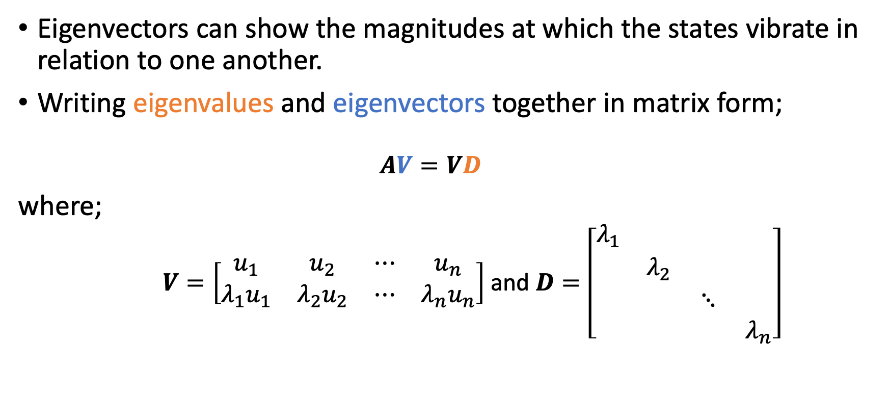
Modal motion in free vibration – Eigenvectors
Eigenvectors can show the magnitudes at which the states vibrate in relation to one another.
Writing eigenvalues and eigenvectors together in matrix form;
$$AV=VD$$
where;
$V=\left[\begin{matrix}u_{1} & u_{2} & ⋯ & u_{n} \\ λ_{1}u_{1} & λ_{2}u_{2} & ⋯ & λ_{n}u_{n}\end{matrix}\right]$ and $D=\left[\begin{matrix}λ_{1} & & & \\ & λ_{2} & & \\ & & ⋱ & \\ & & & λ_{n}\end{matrix}\right]$

Slide 18
Modal motion in free vibration – Eigenvectors
x
x
Using MATLAB ‘eig(A)’ to find the eigenvectors of the example system, A matrix;
Note
The second and fourth columns are the complex conjugates of the first and third columns respectively
Rows three and four are the first and second rows multiplied by their respective eigenvalues
The system can then be characterized by considerably less ‘unique information’
x
x

Slide 19
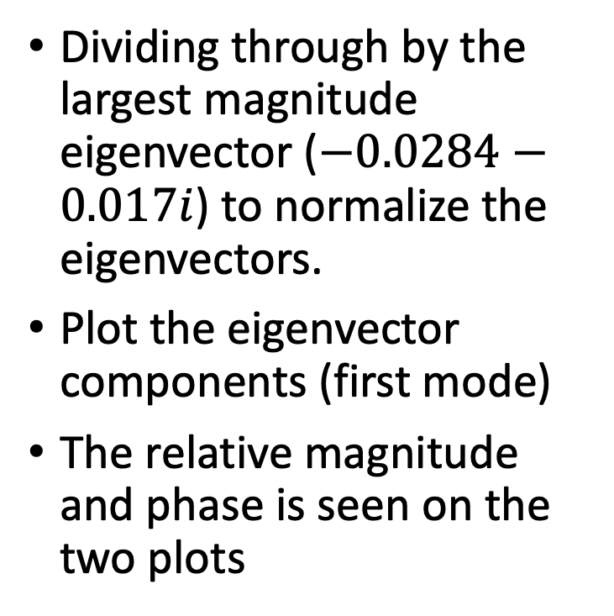
Modal motion in free vibration – Eigenvectors
Dividing through by the largest magnitude eigenvector ($−0.0284−0.017i$) to normalize the eigenvectors.
Plot the eigenvector components (first mode)
The relative magnitude and phase is seen on the two plots
Mode 1

Slide 20
Modal motion in free vibration – Eigenvectors
Similarly for the second (non-conjugate) mode of interest
The relative magnitude and phase is seen on the two plots
Note the differences between first and second modes of vibration
Mode 2

Slide 21
Conclusions
Transfer function vs state space representation
Eigenvalues tell us;
Damped natural frequency
Natural frequency
Damping factor
Damping ratio
Settling time
Percent overshoot
Eigenvectors help us to understand vibration of the modes relative to one another

